Slide 1


BRACT’S
Vishwakarma Institute Of Information Technology
(An Autonomous Institute affiliated to Savitribai Phule Pune University)
FORWARD CHAINING AND BACKWARD CHAINING ALGORITHM
By - Pranav Bire Prafull Bhoirkar

Slide 2
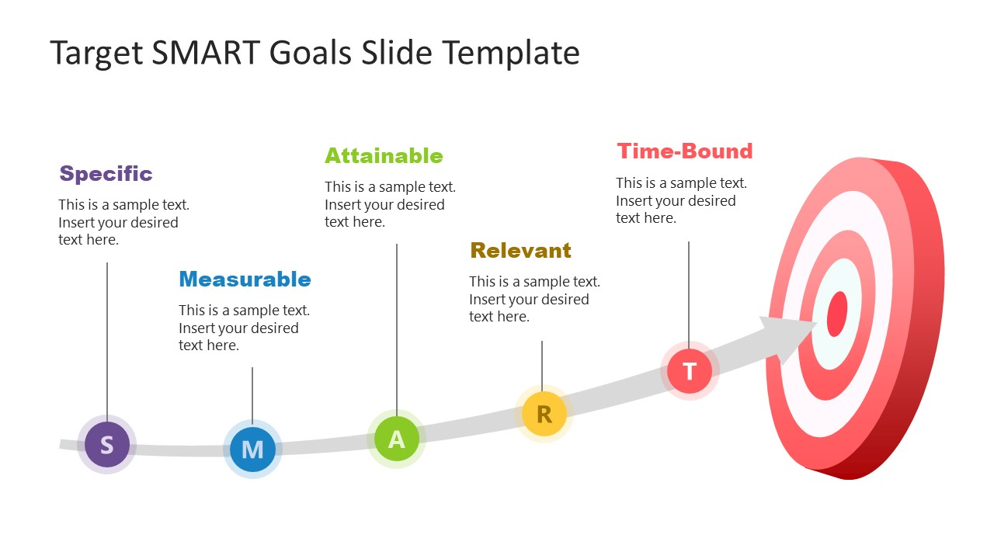
OBJECTIVE
Code Snippet for forward and backward chaining
Introduction To Inference In AI
Backward Chaining
Comparative study of forward and backward chaining
Forward Chaining
C
C
I
F
B

Slide 3
Introduction to Inference in AI
In artificial intelligence, inference mechanisms are essential for logical reasoning and decision-making. They allow systems to derive new information from existing data (facts) and predefined rules.
Forward Chaining is a data-driven reasoning process. It begins with a set of known facts and incrementally applies inference rules to derive new facts, continuing until a conclusion or goal is reached.
This method is commonly used in systems requiring continuous decision-making, such as expert systems and real-time diagnostics.
Backward Chaining is a goal-driven reasoning approach. The system starts with a query or goal (the hypothesis) and works backward through the rules to determine whether the known facts can validate the goal.
It is primarily used in theorem proving, logic programming, and decision support systems.
Both approaches form the foundation for rule-based systems in AI and play a significant role in knowledge-based systems, expert systems, and automated reasoning engines.

Slide 4
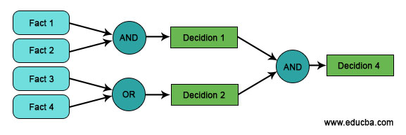
FORWARD CHAINING
Forward Chaining is a reasoning method used in artificial intelligence to infer new information from existing data.
It is often part of a rule-based system, which consists of facts (known truths) and rules (if-then statements) that describe relationships between these facts.
The reasoning process starts with the available data and applies inference rules to produce new information until a specific goal is achieved or no more rules apply.
Efficient for scenarios where new data is continuously available, making it suitable for dynamic environments.
Commonly used in expert systems and production systems, such as:
Medical diagnosis: Derives diseases from symptoms.
Industrial fault detection: Identifies system malfunctions.
Real-time decision-making systems: React to incoming data.

Slide 5
How Does Forward Chaining Operate?
The process begins with a set of initial facts in the knowledge base.
The inference engine checks each rule to see if its conditions are satisfied by the current facts.
When a rule's condition is met, the rule fires (executes), and the resulting new fact is added to the knowledge base.
This process of evaluating and firing rules continues iteratively, adding new facts until:
A goal or conclusion is reached.
No more applicable rules exist.:
It proceeds in a forward direction from facts to conclusions, making it suitable for systems that need continuous data processing.
Forward chaining halts when the desired goal is reached or when no further rules apply.

Slide 6
Advantages
Disadvantages
The straightforward mechanism of starting from known facts makes it easy to implement and understand.
Efficiently handles dynamic data, allowing for continuous updates and real-time decision-making.
Can generate multiple conclusions from a single set of facts, ensuring thorough exploration of the knowledge base.
Provides quick insights and results as soon as new facts are introduced, which is beneficial in applications like diagnostics.
Can be scaled to handle larger knowledge bases and complex rule sets without significant changes to the underlying logic.
As the number of rules and facts increases, the system may become slow, evaluating many irrelevant rules.
It may derive unnecessary conclusions or facts since it doesn’t focus on a specific goal from the start.
Requires significant computational resources for evaluating and firing rules, particularly in complex systems.
May generate redundant facts, cluttering the knowledge base and complicating data management.
It may struggle to efficiently handle situations that require backtracking or complex multi-step reasoning.

Slide 7
APPLI CATION
Expert Systems:
Used in medical diagnosis systems to infer possible diseases based on patient symptoms and medical history.
Production Systems:
Employed in manufacturing processes to control machinery and automate decision-making based on real-time data inputs.
Rule-Based Systems:
Utilized in recommendation engines to suggest products or services by processing user preferences and behaviors.
Automated Reasoning:
Applied in theorem proving to derive logical conclusions from premises and known theorems.
Fault Detection and Diagnosis:
Used in industrial systems to identify and diagnose equipment malfunctions by analyzing sensor data and operational parameters.
Decision Support Systems:
Implemented in financial systems to provide real-time insights and recommendations based on market data and trends.

Slide 8
EXAMPLE
Data /Facts
X = 1
Y = 2
Rules
1. If(X == 1 & Y == 2)
Then Z = 3
2. If(Z = 3)
Then a = 4
Goal
a = 4
X = 1
If (X == 1 & Y == 2)
Then Z = 3
a = 4
Y = 2
If (Z == 3)
Then a = 3

Slide 9
FUTURE ADVANCMENT
Forward Chaining
Parallel Processing:
Modern systems implement parallel rule evaluation, speeding up the inference process in complex, large-scale systems.
Optimized Rule Engines:
Advanced rule engines like Drools and Jess use improved algorithms to manage and process large numbers of rules efficiently.
Hybrid Systems:
Combining forward chaining with other reasoning methods like case-based reasoning or probabilistic models for better decision-making and flexibility in real-time systems.
AI Integration:
Integration with machine learning models helps systems dynamically adjust rules based on new data, improving adaptability.
Scalability Improvements:
New algorithms and data structures (like Rete algorithm) reduce memory consumption and processing time for handling large-scale knowledge bases.

Slide 10
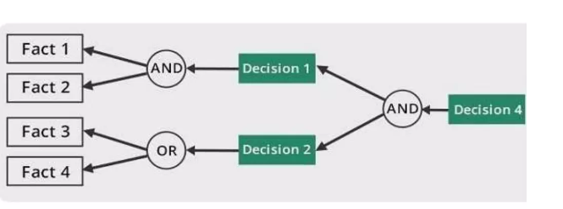
BACKWARD CHAINING
Backward Chaining is a goal-driven reasoning method used in artificial intelligence and logic programming.
Process:
Begins with a specific goal or hypothesis that the system aims to prove or achieve.
Works backward through inference rules, starting from the goal and determining if it can be satisfied by existing facts.
Backward chaining is efficient in goal-oriented systems like theorem proving, diagnostics, and decision-making, where it focuses only on relevant facts to achieve a specific outcome.
commonly used in:
Theorem proving: Validates mathematical statements by working backward from the conclusion.
Decision-making systems: Determines actions based on desired outcomes in expert systems.

Slide 11
How Does Backward Chaining Operate?
The system begins with a specific goal or hypothesis it wants to prove or achieve.
It identifies rules that could lead to the goal, focusing on rules with the goal as the conclusion.
The system checks if the conditions (premises) of these rules are met by existing facts.
If a condition is not satisfied, it treats it as a sub-goal and looks for facts or rules that can support it.
This process continues, working backward through multiple layers of sub-goals until:
The original goal is proven by the facts.
Or no further rules can be applied, resulting in failure.

Slide 12
Advantages
Disadvantages
Focuses directly on achieving a specific goal, making the process more efficient by limiting unnecessary rule evaluations.
Only explores relevant paths toward the goal, making it effective in systems with a large number of facts and rules.
Uses fewer computational resources as it only works backward from the goal rather than generating all possible conclusions like forward chaining.
Ideal for systems where a specific answer or conclusion is needed, such as expert systems or diagnostic applications.
Can efficiently deal with complex reasoning processes by breaking down the problem into smaller, manageable sub-goals.
May require evaluating many rules backward, which can become slow and complex with a large number of potential rules.
Needs a well-defined goal from the start, making it less suitable for situations where the goal is not clear or constantly changing.
If there are no supporting facts for the goal, backward chaining may not work, leading to incomplete or incorrect reasoning.
It doesn’t explore all possible conclusions like forward chaining, which can miss valuable inferences or insights beyond the specific goal.
Works backward from a goal, so it is less efficient in environments where new data is continuously being added in real-time.

Slide 13
APPLI CATION
Expert Systems:
Commonly used in systems for diagnosis and troubleshooting (e.g., medical diagnosis systems), where the goal is to determine the root cause of a problem based on symptoms.
Theorem Proving:
Utilized in mathematical and logical theorem proving, where it works backward from the theorem to be proved by checking supporting axioms and rules.
Legal Reasoning Systems:
Helps in legal expert systems to work backward from a legal conclusion (e.g., innocence or guilt) and gather supporting evidence or precedents.
Decision-Making Systems:
Employed in AI-driven decision systems that need to justify a decision by working backward from an outcome to check if conditions support it.
Production and Planning Systems:
Used in industrial planning systems to determine the steps required to achieve a specific goal, such as reaching a production target.

Slide 14
EXAMPLE
Data /Facts
X = 1
Y =2
Rules
1. If(X == 1 & Y == 2)
Then Z = 3
2. If(Z = 3)
Then a = 4
Goal
a = 4
X = 1
If (X == 1 & Y == 2)
Then Z = 3
a = 4
Y = 2
If (Z == 3)
Then a = 3

Slide 15
FUTURE ADVANCMENT
Backward Chaining
Constraint Logic Programming (CLP):
Introduces constraints to backward chaining to improve its efficiency in complex problem-solving by pruning unnecessary branches.
Probabilistic Backward Chaining:
Combining backward chaining with probabilistic reasoning (e.g., Bayesian networks) allows handling of uncertain or incomplete information.
Enhanced Search Algorithms:
Use of more advanced search strategies, like heuristic search and A algorithms*, to speed up goal-driven problem solving.
Hybrid Inference Systems:
Integrating backward chaining with forward chaining for more adaptive reasoning in systems that require both data-driven and goal-driven approaches.
AI-Enhanced Decision Support:
Backward chaining is now integrated into AI-driven decision support systems, improving the ability to reason with complex datasets in domains like law, finance, and healthcare.

Slide 16
FORWARD V/ S BACKWARD
Aspect | Forward Chaining | Backward Chaining
Direction | Data → Conclusion | Goal → Data
Trigger | Facts | Query/Goal
Best for | Real – time Systems(e.g., expert systems) | Problem – solving or hypothesis
Efficiency | May explore unnecessary facts | Focused on achieving the goal
Use cases | Medical Diagnosis, Fault detection | Theorem proving , legal reasoning

Slide 17
THANK YOU

